Slide 1

WHY DONATE TIME
We can not live in an isolation because society affects every aspect of life. When we work for society, society works for us

Slide 2
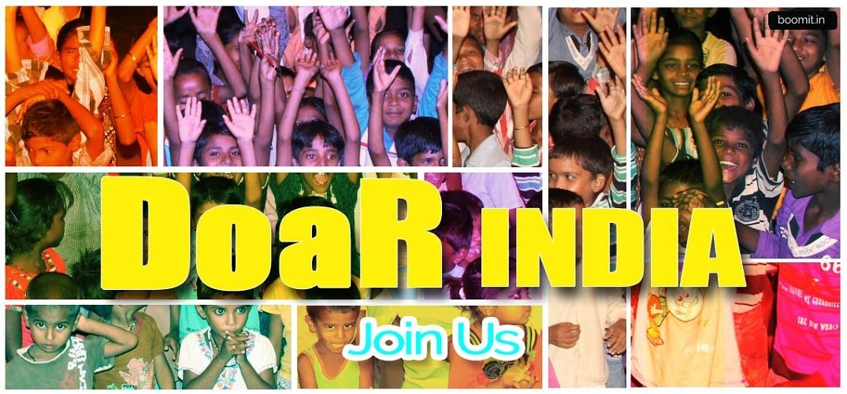
overview
Donate an Hour is a volunteering platform. Here people from diverse backgrounds and different walks of society, join together with the aim of giving it back to the society. This is a registered trust since 2015 where a large number of less privileged people are getting benefit from the services and the number is growing! Hence, our motto is, “Donate time to shape lives”

Slide 3
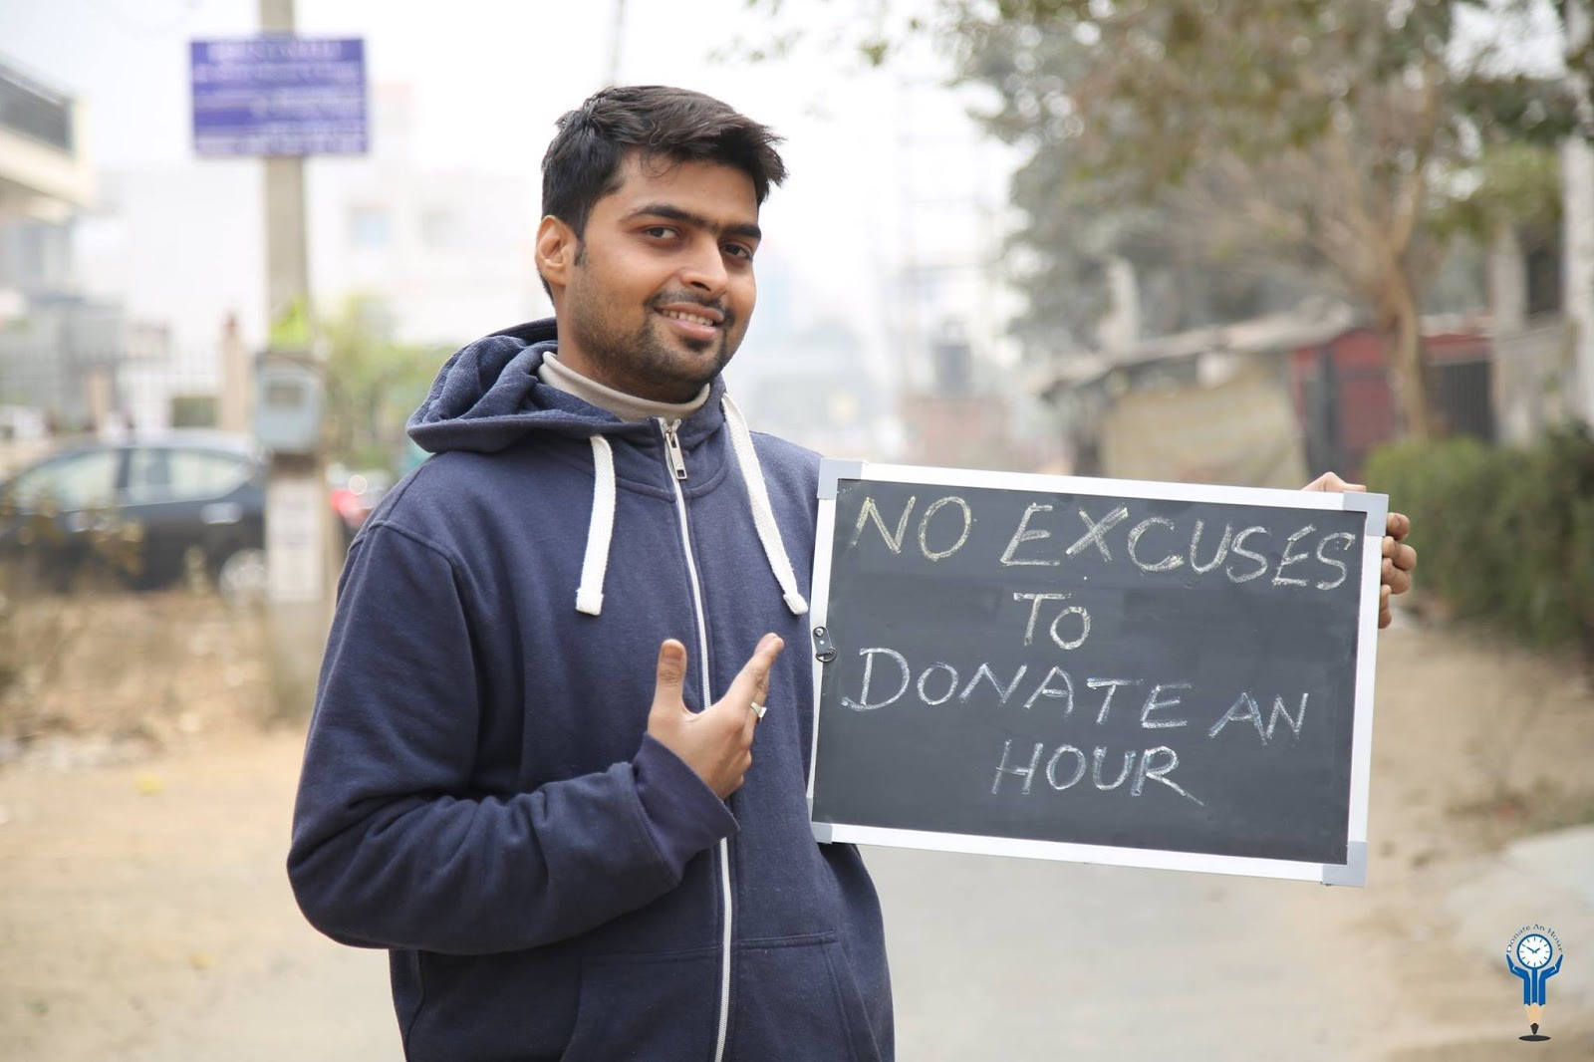
Problem Areas We Cater
EDUCATION
RENAISSANCE
HEALTH

Slide 4
1.EDUCATION

Slide 5
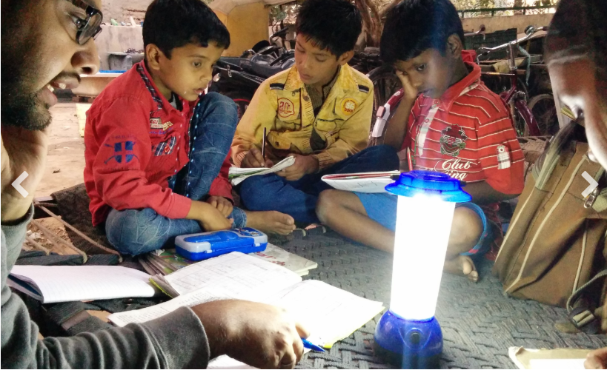
Utthan
Utthan means upliftment. This is our flagship program that aims to provide supplementary of parental support to the children from poor and disadvantaged socio-economic background. Under this program volunteers a run daily or weekend classes after or before their office hours and mentor underprivileged children. Some volunteers provide home tuition as well.

Slide 6
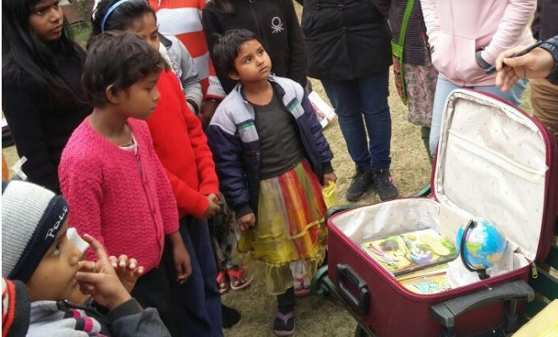
Suitcase Library
Our Suitcase Library is a mobile library which provides a cost effective means of encouraging children back to learning and also attracts the elders, who read newspapers which are not available in slums. We are particularly in need of elementary or early intermediate story books in Hindi and English.

Slide 7
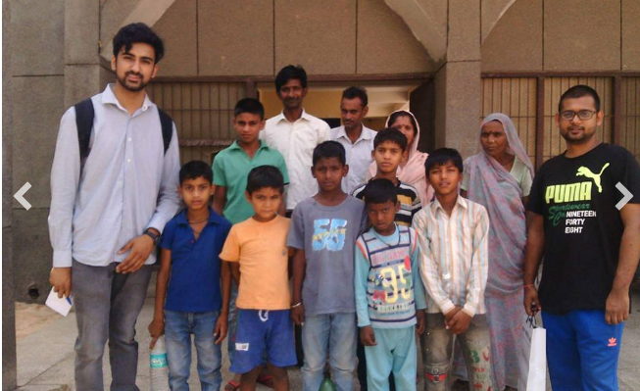
School Chalo
This program aims to enrol the children in a recognised school who have dropped out the studies and now they are out of the education system due to their social economical reasons.
In the academic year of 2015-2016, we have enrolled 20 children in government school In the academic year pf 2016-2017, we have enrolled 100 children in government and in private schools.

Slide 8
2. RENAISSANCE

Slide 9
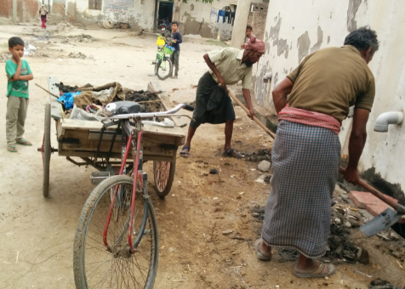
Cleaning and Garbage Management
A population of 2000 in the village Kherla ( Nuh district) is struggling to get the clean environment for the residents. DoaR volunteers are working on the following areas since April 2018 -
1.A facility for door to door collection of garbage
2.Daily cleaning of streets
3.Weekly cleaning of drainage by removing sludge
4.Recycling the organic waste
5.Educating the shopkeepers on keeping dustbin outside their shops
6.Educating villagers on the harmful effects of plastic burning

Slide 10
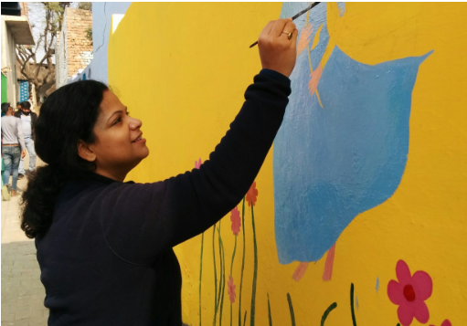
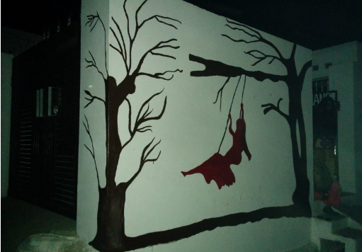
Employment Generation
1: Cleanliness and Painting
2: Employment by Tourism

Slide 11
3.HEALTH

Slide 12
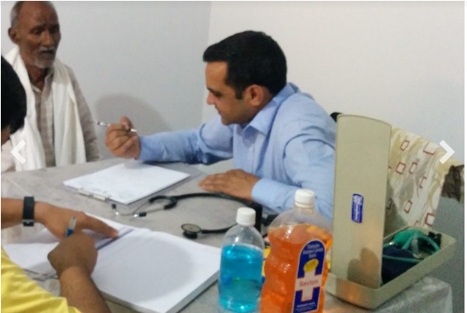
Affordable Medical Consultation
This project aims to provide medical consultation and diagnostics at concessional rate to underprivileged in the urban slum. This program works on 3 principals- 1) Awareness 2) Prevention 3)Consultation ​ Participating doctors are charging only nominal consultation fee from patients.

Slide 13
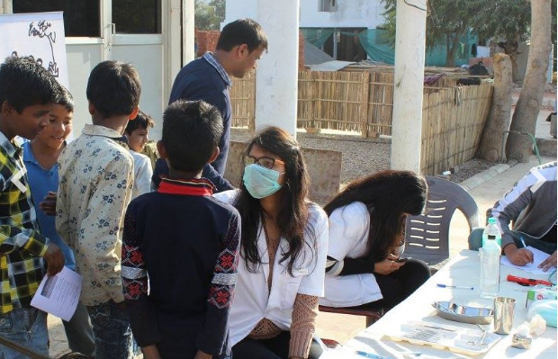
Health Camps
We organized regular health camps and invite senior doctors who are not available on regular basis for secondary opinion on critical cases.
This is also an opportunity for slum dwellers to get one day free of cost services where they can not afford to pay doctors consultation.

Slide 14
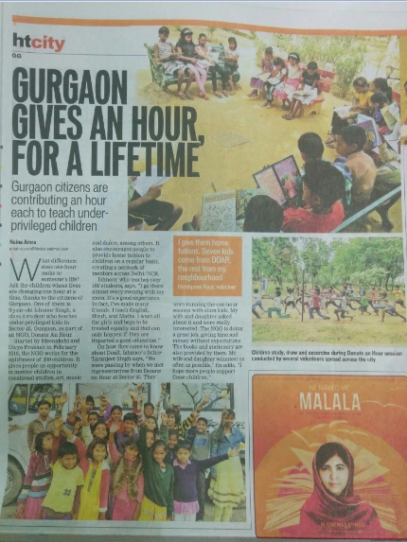
DOAR IN NEWS

